Slide 1
Depth Controllable Super-Resolution Network
Chung-Ang University (by Dohyun Kim) School of Computer Science and Engineering, Chung-Ang University E-mails: dohyun.cau@gmail.com

Slide 2
Introduction

Slide 3
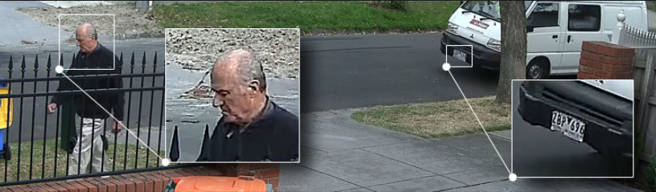
Introduction - Preliminary
Super-resolution

Slide 4
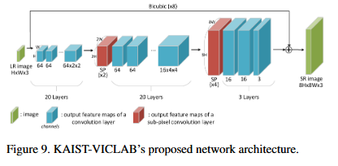
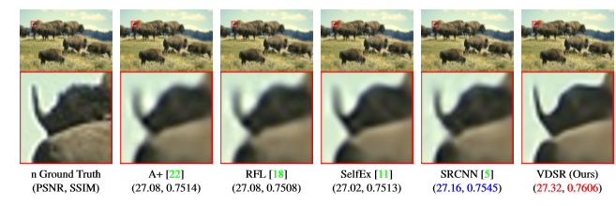
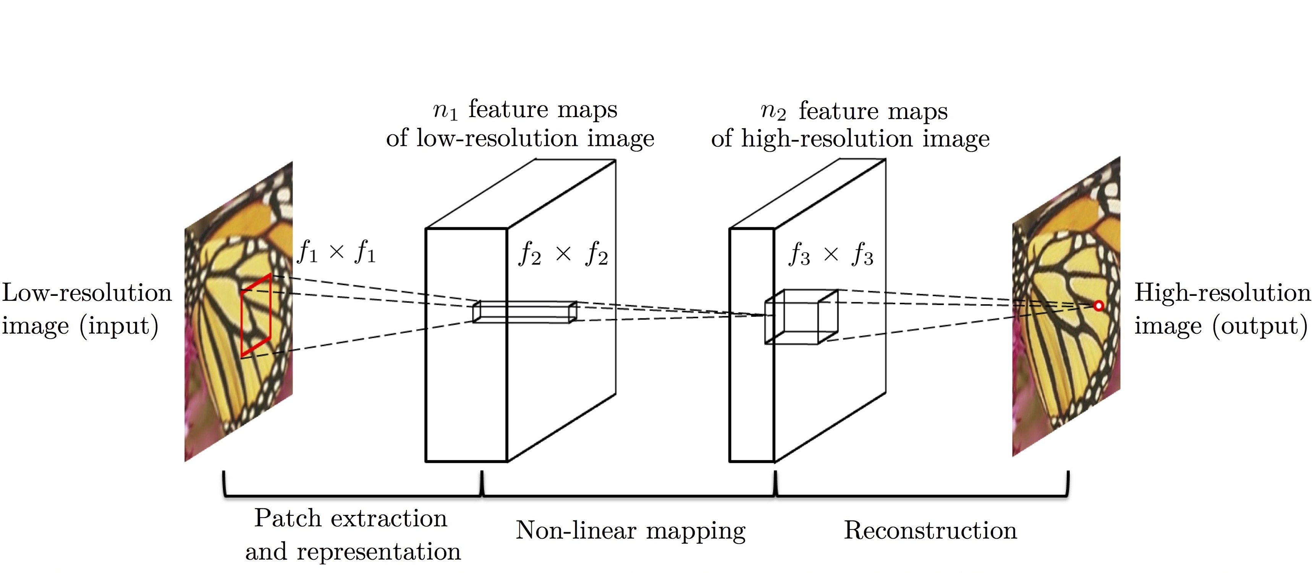
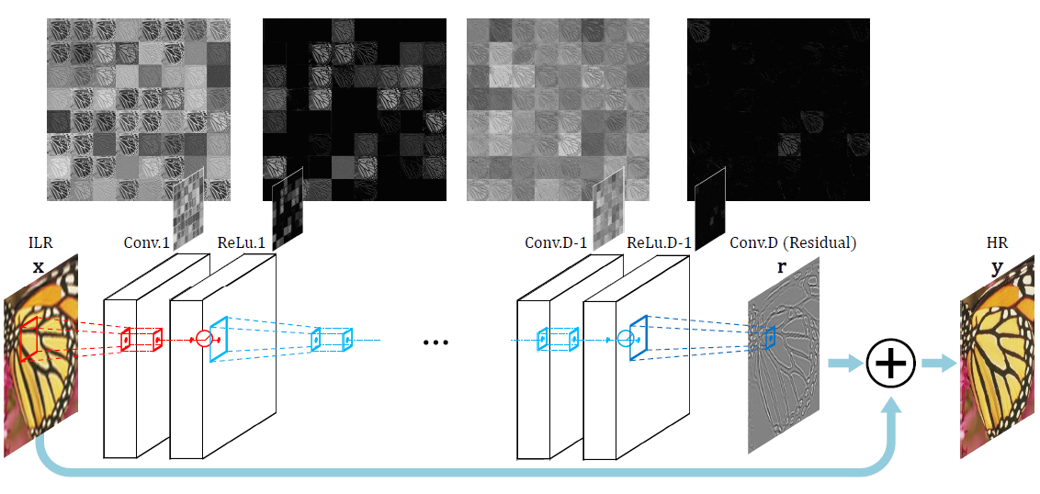
Introduction - Preliminary
Super-resolution with Convolution Neural Network
SRCNN
VDSR

Slide 5
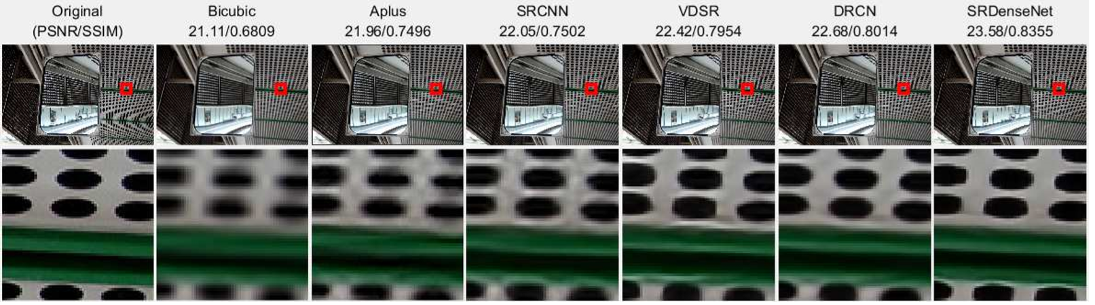
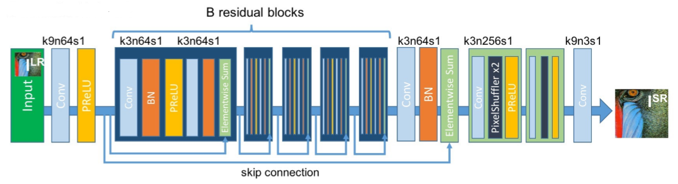
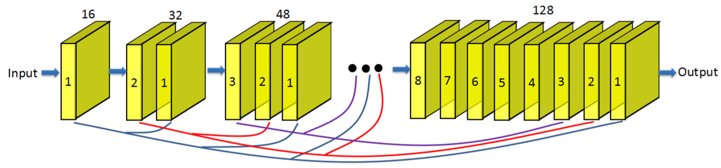
Introduction - Preliminary
Super-resolution with Convolution Neural Network
SRResNet
SRDenseNet

Slide 6
Introduction - Preliminary
Implemental baseline - VDSR
18 hidden layers
(H x W x 3)
(rH x rW x 3)
(rH x rW x 64)
(rH x rW x 3)
: LR mage
Skip connection
: Bicubic upscaled Image
: Input layer
Multi-Scale (x2 ~ x4)
20 CNN layer
Global skip connection
: Hidden layer
: Output branch
: Reconstruction layer
: Skip connection

Slide 7
Introduction
Trade-off relationship between speed and performance over depth
: depth 0 (same as Bicubic)
Shallow, Faster, lower performance
Deeper, slower, higher performance
: depth 4
(similar to SRCNN)
Depth | Bicubic | 4 | 6 | 8 | 11 | 14 | 17 | 20
PSRN (dB) | 30.4 | 32.56 | 33.01 | 33.229 | 33.379 | 33.435 | 33.495 | 33.523
SSIM | 0.8682 | 0.91 | 0.916 | 0.918 | 0.92 | 0.92 | 0.921 | 0.922
Processing time (CPU) | 0.002 | 0.321 | 0.5468 | 0.7725 | 0.994 | 1.317 | 1.622 | 1.96
Processing time (GPU) | 0.001 | 0.01 | 0.012 | 0.0152 | 0.0189 | 0.0224 | 0.0262 | 0.0305
# of parameters | 0 | 75K | 148K | 222K | 333K | 444K | 555K | 665K
: depth 6
: depth 11
(processing time have measured on butterfly, 512 x 768)
: depth 20
(same as VDSR)

Slide 8


Introduction - Motivation
Model selection problem
Model selection is important of efficiency and stability of system
Shallow model
Deeper model
Faster, lighter
Lower performance
Suit for mobile, IoT devices
Slower, heavier
Higher performance
Suit for server, station

Slide 9



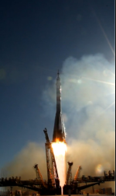

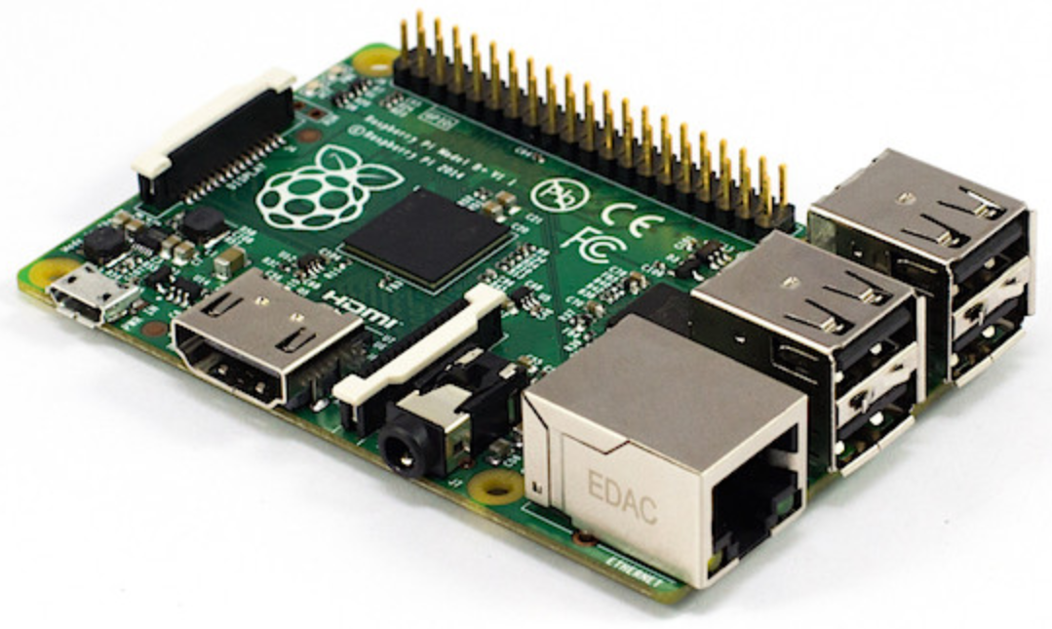

Introduction - Motivation
Necessity of Dynamic model adaptation
However, sometimes it is hard to determine optimal model before running time
For examples, when
?
? fps
? fps
input rate (or image size) is unfixed
required scale is changed (x4 is heavier than x2)
performance of system fluctuates frequently
- during running time
Service provide do not have any information about clients
…?
Shallow model
Deeper model

Slide 10

Introduction - Motivation
Adaptation with bag of models
One reasonable solution is dynamically selecting SR models in the option bags
Bag of models
Current selected model
? fps
? fps

Slide 11
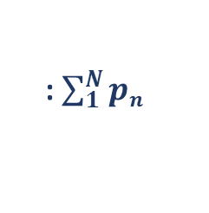
Introduction - Motivation
Limitation of adaptation with bag of models
However, additional memory is required in proportion to the number of models used
Model switching may cause computational overhead (according to system)
Bag of models
# of parameters : p₁
Unload previous model
: p₂
: p₃
model switching
…
Load next model
: p_{N}
: $\sum_{1}^{N}{pn}$

Slide 12
Goal of this paper
The depth of model used for inference should be controllable on running time
The performance at each depth should be comparable to its baseline
The model should be configured as a single network

Slide 13
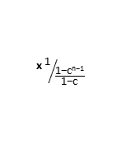
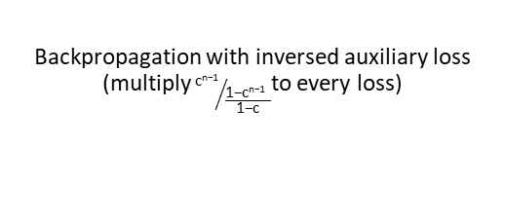
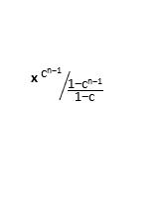
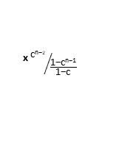
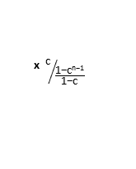
Proposed method : Depth Controllable SR Network
Overall architecture of proposed networks
Proposed networks
18 hidden layers
(rH x rW x 64)
(rH x rW x 3)
(H x W x 3)
(rH x rW x 3)
Output branch
(rH x rW x 3)
Proposed training method
Frozen
-
2*
Original
HR image
Loss₁
Loss₂
Loss_{n-1}
Loss_{n}
: LR mage
x ${\text{1}}/{\frac{\text{1−}\text{cn}\text{−1}}{\text{1−}\text{c}}}$
x ${\text{c}}/{\frac{\text{1−}\text{cn}\text{−1}}{\text{1−}\text{c}}}$
x ${\text{c}\text{n}\text{−}2}/{\frac{\text{1−}\text{cn}\text{−1}}{\text{1−}\text{c}}}$
x ${\text{c}\text{n}\text{−1}}/{\frac{\text{1−}\text{cn}\text{−1}}{\text{1−}\text{c}}}$
: Bicubic upscaled Image
Backpropagation with inversed auxiliary loss (multiply${ \text{c}\text{n}\text{−1}}/{\frac{\text{1−}\text{cn}\text{−1 } }{\text{1−}\text{c}}}$to every loss)
: Input layer
: Output branch
: Hidden layer
: Skip connection
: Reconstruction layer
: Inversed auxiliary loss

Slide 14
Depth Controllable SR Network

Slide 15
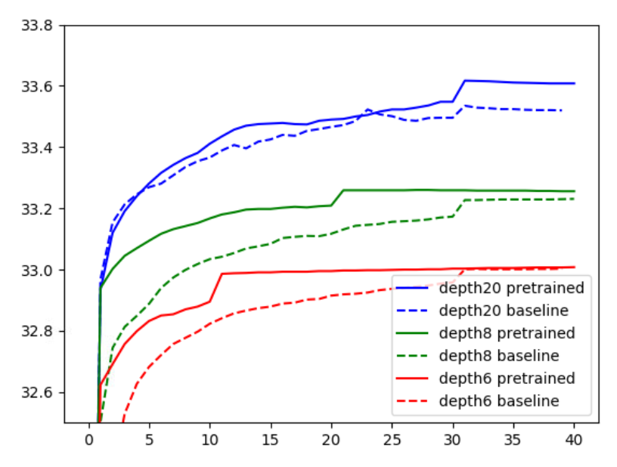
Proposed method : Depth Controllable SR Network
Motivation : depth-wise fine-tuning
Depth | Bicubic PSNR(dB)/SSIM | 6 PSNR(dB)/SSIM | 8 PSNR(dB)/SSIM | 20 (VDSR) PSNR(dB)/SSIM
Paper Baseline | 30.4 / 0.8682 | - | - | 33.6 / 0.921
Implemental Baseline | 30.4 / 0.8682 | 33.01/0.916 | 33.229/0.918 | 33.523/0.921
Depth-wise fine-tuning | 30.4 / 0.8682 | 33.08/0.916 | 33.256/0.9184 | 33.548/0.9215
: depth 4
(similar to SRCNN)
: depth 6
Training with weights which pretrained at lower depth helps model to converge fast and to be trained stably
This indirectly present there is close relation between depth
(similar observation is addressed in B. Lim et al.*)
Then, Our insight is that the model can share their weight over depth
: depth 20
(same as VDSR)
Enhanced Deep Residual Networks for Single Image Super-Resolution (EDSR) [https://arxiv.org/abs/1707.02921]

Slide 16
Proposed method : Depth Controllable SR Network
Output branch
18 hidden layers
(rH x rW x 64)
(H x W x 3)
(rH x rW x 3)
Output branch
(rH x rW x 3)
(rH x rW x 3)
: LR mage
: Bicubic upscaled Image
: Input layer
: Hidden layer
: Output branch
: Reconstruction layer
: Skip connection

Slide 17
Proposed method : Depth Controllable SR Network
Output branch
18 hidden layers
(rH x rW x 64)
(H x W x 3)
(rH x rW x 3)
Output branch
(rH x rW x 3)
2*
-
(rH x rW x 3)
Original
HR image
Loss₁
Loss₂
Loss₃
Loss_{n-1}
Loss_{n}
Backpropagation with averaged loss (multiply 1/n to every loss)
Special case of auxiliary loss* when weight is 1/n instead of 0.3^{n}
* L1 loss result higher reconstruction score
* Rethinking the inception architecture for computer vision (InceptionV2) [https://arxiv.org/pdf/1512.00567v1.pdf ]

Slide 18
Proposed method : Depth Controllable SR Network (DCSRNet)
Skip connection strategy
Contiguous skip connection
(rH x rW x 64)
(H x W x 3)
(rH x rW x 3)
Output branch
(rH x rW x 3)
Progressive skip connection
(rH x rW x 64)
(H x W x 3)
(rH x rW x 3)
Output branch
(rH x rW x 3)

Slide 19
Proposed method : Depth Controllable SR Network (DCSRNet)
Skip connection strategy
Contiguous skip connection
(rH x rW x 64)
Better performance !
(H x W x 3)
(rH x rW x 3)
Output branch
(rH x rW x 3)
Progressive skip connection
(rH x rW x 64)
(H x W x 3)
(rH x rW x 3)
Output branch
(rH x rW x 3)

Slide 20
Proposed method : Depth Controllable SR Network (DCSRNet)
Evaluation result
Depth | Bicubic PSNR(dB)/SSIM | 4 (SRCNN) PSNR(dB)/SSIM | 6 PSNR(dB)/SSIM | 8 PSNR(dB)/SSIM | 11 PSNR(dB)/SSIM | 14 PSNR(dB)/SSIM | 17 PSNR(dB)/SSIM | 20 (VDSR) PSNR(dB)/SSIM
Paper Baseline | 30.4 / 0.8682 | 32.7 / 0.909 | - | - | - | - | - | 33.6 / 0.921
Implemental Baseline | 30.4 / 0.8682 | 32.56/0.91 | 33.01/0.916 | 33.229/0.918 | 33.379/0.92 | 33.435/0.92 | 33.46/0.9209 | 33.523/0.921
Averaged loss | 30.4 / 0.8682 | 32.19/0.9058 | 32.79/0.9128 | 33.11/0.9164 | 33.3/0.9187 | 33.48/0.9208 | 33.56/0.9218 | 33.59/0.9222
Averaged loss (Progressive skip connection) | 30.4 / 0.8682 | 32.182/0.905 | 32.716/0.912 | 33.06/0.916 | 33.231/0.917 | 33.356/0.919 | 33.4/0.92 | 33.446/0.92
Performance increases proportional to depth of hidden layer
Averaged loss seems to make training stable and be available to leverage performance of deeper model
Contiguous skip connection shows better result than progressive skip connection

Slide 21
Proposed method : Depth Controllable SR Network (DCSRNet)
Performance bias problem
Depth | Bicubic PSNR(dB)/SSIM | 4 (SRCNN) PSNR(dB)/SSIM | 6 PSNR(dB)/SSIM | 8 PSNR(dB)/SSIM | 11 PSNR(dB)/SSIM | 14 PSNR(dB)/SSIM | 17 PSNR(dB)/SSIM | 20 (VDSR) PSNR(dB)/SSIM
Paper Baseline | 30.4 / 0.8682 | 32.7 / 0.909 | - | - | - | - | - | 33.6 / 0.921
Implemental Baseline | 30.4 / 0.8682 | 32.56/0.91 | 33.01/0.916 | 33.229/0.918 | 33.379/0.92 | 33.435/0.92 | 33.46/0.9209 | 33.523/0.921
Averaged loss | 30.4 / 0.8682 | 32.19/0.9058 | 32.79/0.9128 | 33.11/0.9164 | 33.3/0.9187 | 33.48/0.9208 | 33.56/0.9218 | 33.59/0.9222
Averaged loss (Progressive skip connection) | 30.4 / 0.8682 | 32.182/0.905 | 32.716/0.912 | 33.06/0.916 | 33.231/0.917 | 33.356/0.919 | 33.4/0.92 | 33.446/0.92
However, training with averaged loss deteriorates performance at shallow layer
Moreover, it is hard to predict which depth this deterioration start from

Slide 22
Proposed method : Depth Controllable SR Network (DCSRNet)
Attempts to improve : Stacked transfer learning
Gradually stacking additional layers to the previous model
Stacked transfer learning
Frozen
Stacked transfer learning
Frozen

Slide 23
Proposed method : Depth Controllable SR Network (DCSRNet)
Limitation of Stacked transfer learning
Depth | Bicubic PSNR(dB)/SSIM | 4 (SRCNN) PSNR(dB)/SSIM | 6 PSNR(dB)/SSIM | 8 PSNR(dB)/SSIM | 11 PSNR(dB)/SSIM | 14 PSNR(dB)/SSIM | 17 PSNR(dB)/SSIM | 20 (VDSR) PSNR(dB)/SSIM
Paper Baseline | 30.4 / 0.8682 | 32.7 / 0.909 | - | - | - | - | - | 33.6 / 0.921
Implemental Baseline | 30.4 / 0.8682 | 32.56/0.91 | 33.01/0.916 | 33.229/0.918 | 33.379/0.92 | 33.435/0.92 | 33.46/0.9209 | 33.523/0.921
Averaged loss | 30.4 / 0.8682 | 32.19/0.9058 | 32.79/0.9128 | 33.11/0.9164 | 33.3/0.9187 | 33.48/0.9208 | 33.56/0.9218 | 33.59/0.9222
Staked transfer learning (soft pretraining) | 30.4 / 0.8682 | 32.47/0.91 | 32.86/0.9140 | 32.952/0.9148 | 32.959/0.9149 | 32.96/0.9149 | 32.96/0.9149 | 32.965/0.9144
Stacked transfer learning (hard pretraining) | 30.4 / 0.8682 | 32.56/0.91 | 32.68/0.9121 | 32.72/0.9125 | 32.724/0.9125 | 32.73/0.9126 | 32.73/0.9126 | 32.73/0.9126
Shallow layers can be trained explicitly
However, the performance of deeper layer are deteriorated since there is no consideration of sharing parameters with deep layers

Slide 24
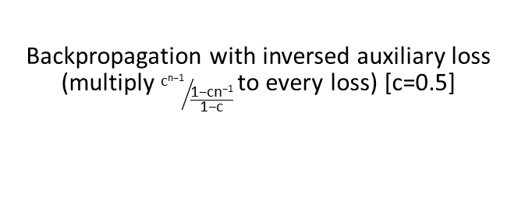
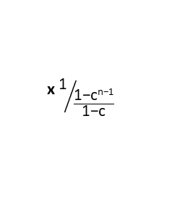
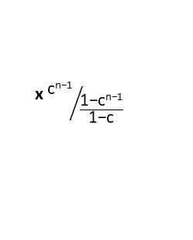
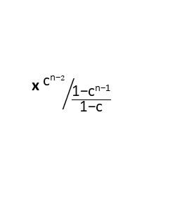
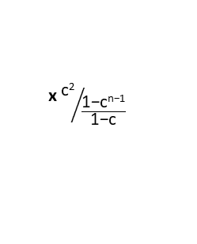
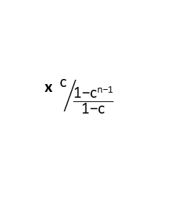
Proposed method : Depth Controllable SR Network (DCSRNet)
Compromise plan : Stacked transfer learning with inversed auxiliary loss
(H x W x 3)
(rH x rW x 3)
Output branch
2*
-
Original
HR image
Loss₁
Loss₂
Loss₃
Loss_{n-1}
Loss_{n}
x ${\text{1}}/{\frac{\text{1−}\text{cn}\text{−1}}{\text{1−}\text{c}}}$
x ${\text{c}}/{\frac{\text{1−}\text{cn}\text{−1}}{\text{1−}\text{c}}}$
x ${\text{c}\text{2}}/{\frac{\text{1−}\text{cn}\text{−1}}{\text{1−}\text{c}}}$
x ${\text{c}\text{n}\text{−}2}/{\frac{\text{1−}\text{cn}\text{−1}}{\text{1−}\text{c}}}$
x ${\text{c}\text{n}\text{−1}}/{\frac{\text{1−}\text{cn}\text{−1}}{\text{1−}\text{c}}}$
Backpropagation with inversed auxiliary loss (multiply ${\text{c}\text{n}\text{−1}}/{\frac{\text{1−}\text{cn}\text{−1}}{\text{1−}\text{c}}}$to every loss) [c=0.5]
stacking with multiplying progressively smaller weight to loss against depth of layers
The closer c is to 1, the closer it is to the averaged loss, so that the more it considers parameter sharing with deep layers, vise versa.

Slide 25
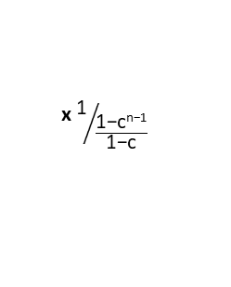
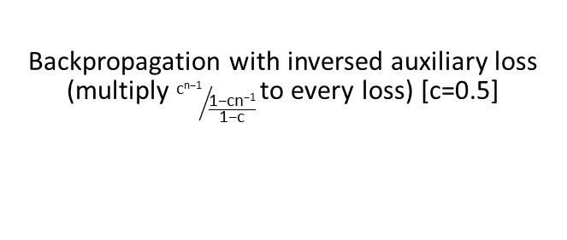
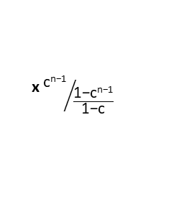
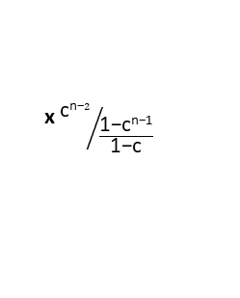
Proposed method : Depth Controllable SR Network (DCSRNet)
Compromise plan : Stacked transfer learning with inversed auxiliary loss
Extra Step 1
Frozen
(H x W x 3)
(rH x rW x 3)
Output branch
(rH x rW x 3)
(rH x rW x 3)
Loss₁
Loss₂
Loss_{n-1}
Loss_{n}
x ${\text{1}}/{\frac{\text{1−}\text{cn}\text{−1}}{\text{1−}\text{c}}}$
x ${\text{c}}/{\frac{\text{1−}\text{cn}\text{−1}}{\text{1−}\text{c}}}$
x ${\text{c}\text{n}\text{−}2}/{\frac{\text{1−}\text{cn}\text{−1}}{\text{1−}\text{c}}}$
x ${\text{c}\text{n}\text{−1}}/{\frac{\text{1−}\text{cn}\text{−1}}{\text{1−}\text{c}}}$
Backpropagation with inversed auxiliary loss (multiply ${\text{c}\text{n}\text{−1}}/{\frac{\text{1−}\text{cn}\text{−1}}{\text{1−}\text{c}}}$to every loss) [c=0.5]
stacking with multiplying progressively smaller weight to loss against depth of layers
The closer c is to 1, the closer it is to the averaged loss, so that the more it considers parameter sharing with deep layers, vise versa.

Slide 26
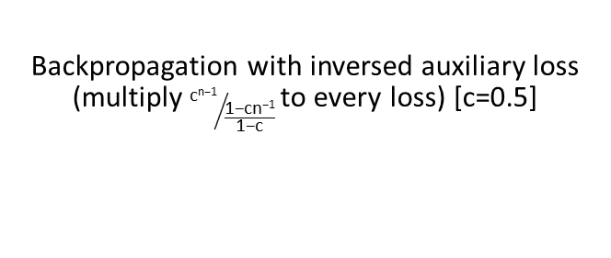
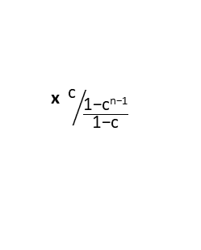
Proposed method : Depth Controllable SR Network (DCSRNet)
Compromise plan : Stacked transfer learning with inversed auxiliary loss
Extra Step 2
Frozen
Frozen
(H x W x 3)
(rH x rW x 3)
Output branch
(rH x rW x 3)
(rH x rW x 3)
Loss₁
Loss₂
Loss_{n-1}
Loss_{n}
x ${\text{1}}/{\frac{\text{1−}\text{cn}\text{−1}}{\text{1−}\text{c}}}$
x ${\text{c}}/{\frac{\text{1−}\text{cn}\text{−1}}{\text{1−}\text{c}}}$
x ${\text{c}\text{n}\text{−}2}/{\frac{\text{1−}\text{cn}\text{−1}}{\text{1−}\text{c}}}$
x ${\text{c}\text{n}\text{−1}}/{\frac{\text{1−}\text{cn}\text{−1}}{\text{1−}\text{c}}}$
Backpropagation with inversed auxiliary loss (multiply ${\text{c}\text{n}\text{−1}}/{\frac{\text{1−}\text{cn}\text{−1}}{\text{1−}\text{c}}}$to every loss) [c=0.5]
stacking with multiplying progressively smaller weight to loss against depth of layers
The closer c is to 1, the closer it is to the averaged loss, so that the more it considers parameter sharing with deep layers, vise versa.

Slide 27
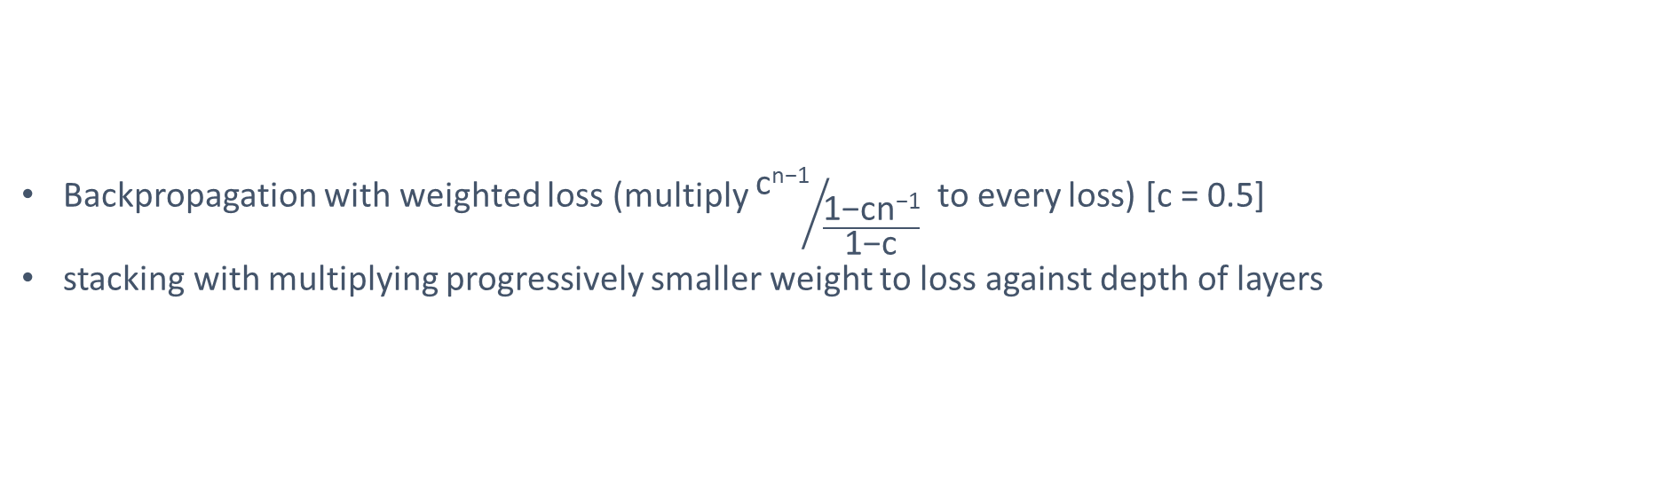
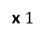
Proposed method : Depth Controllable SR Network (DCSRNet)
Compromise plan : Stacked transfer learning with inversed auxiliary loss
Extra Step n
Frozen
Frozen
Frozen
Frozen
Frozen
(H x W x 3)
(rH x rW x 3)
Output branch
(rH x rW x 3)
Loss₁
x $1$
Backpropagation with weighted loss (multiply ${\text{c}\text{n}\text{−1}}/{\frac{\text{1−}\text{cn}\text{−1}}{\text{1−}\text{c}}}$ to every loss) [c = 0.5]
stacking with multiplying progressively smaller weight to loss against depth of layers
The closer c is to 1, the closer it is to the averaged loss, so that the more it considers parameter sharing with deep layers, vise versa.

Slide 28
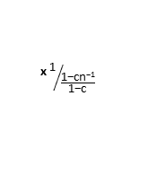
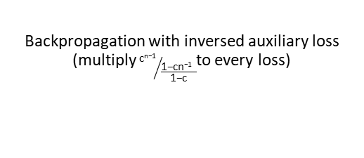
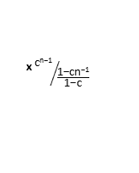
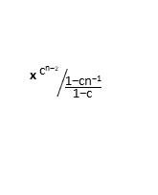
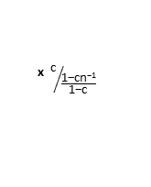
Proposed method : Depth Controllable SR Network (DCSRNet)
Compromise plan : Stacked transfer learning with inversed auxiliary loss
Pretrained model with average loss
Fine tuning over Pretrained model
-
2*
Loss_{n}
Original
HR image
Loss₁
Loss₂
Loss₃
Loss_{n-1}
Backpropagation with averaged loss (multiply 1/n to every loss)
-
2*
Original
HR image
Loss₁
Loss₂
Loss₃
Loss_{n-1}
Loss_{n}
x ${\text{1}}/{\frac{\text{1−}\text{cn}\text{−1}}{\text{1−}\text{c}}}$
x ${\text{c}}/{\frac{\text{1−}\text{cn}\text{−1}}{\text{1−}\text{c}}}$
x ${\text{c}}/{\frac{\text{1−}\text{cn}\text{−1}}{\text{1−}\text{c}}}$
x ${\text{c}\text{n}\text{−}2}/{\frac{\text{1−}\text{cn}\text{−1}}{\text{1−}\text{c}}}$
x ${\text{c}\text{n}\text{−1}}/{\frac{\text{1−}\text{cn}\text{−1}}{\text{1−}\text{c}}}$
Backpropagation with inversed auxiliary loss (multiply${ \text{c}\text{n}\text{−1}}/{\frac{\text{1−}\text{cn}\text{−1 } }{\text{1−}\text{c}}}$to every loss)
Stacking over the model which pretrained with averaged loss can make training more stable, and improve overall performance

Slide 29
Experiments and Evaluations

Slide 30
Proposed method : Depth Controllable SR Network (DCSRNet)
Final evaluation result
Depth |  | Bicubic PSNR(dB)/SSIM | 4 (SRCNN) PSNR(dB)/SSIM | 6 PSNR(dB)/SSIM | 8 PSNR(dB)/SSIM | 11 PSNR(dB)/SSIM | 14 PSNR(dB)/SSIM | 17 PSNR(dB)/SSIM | 20 (VDSR) PSNR(dB)/SSIM
Set5
Paper Baseline | x 2 x 3 x 4 | 33.66/0.9299 30.40/0.8682 28.42/0.8104 | 36.66/0.9542 32.7/0.909 30.48/0.8628 | - | - | - | - | - | 37.53/0.9587 33.6/0.921 31.35/0.8838
Implemental Baseline | x 2 x 3 x 4 | 33.66/0.9299 30.40/0.8682 28.42/0.8104 | 36.56/0.9551 32.56/0.91 30.29/0.8649 | 37.05/0.9577 33.01/0.916 30.64/0.8736 | 37.22/0.9584 33.229/0.918 30.84/0.8774 | 37.33/0.9589 33.379/0.92 30.97/0.8795 | 37.36/0.9591 33.435/0.92 31.07/0.8816 | 37.37/0.9592 33.46/0.9209 31.1/0.8834 | 37.4/0.8252 33.523/0.921 31.15/0.8837
Averaged loss | x 2 x 3 x 4 | 33.66/0.9299 30.40/0.8682 28.42/0.8104 | 35.59/0.931 32.19/0.9058 29.81/0.8523 | 36.82/0.9501 32.79/0.9128 30.45/0.869 | 37.13/0.9563 33.11/0.9164 30.7/0.8745 | 37.27/0.9579 33.3/0.9187 30.89/0.8784 | 37.39/0.9582 33.48/0.9208 31.12/0.882 | 37.43/0.9594 33.56/0.9218 31.21/0.8837 | 37.45/0.9595 33.59/0.9222 31.26/0.8845
inversed auxiliary loss 0.5 | x 2 x 3 x 4 | 33.66/0.9299 30.40/0.8682 28.42/0.8104 | 36.26/0.9537 32.43/0.9093 30.13/0.8612 | 36.98/0.9572 32.97/0.915 30.58/0.8722 | 37.18/0.9582 33.18/0.9172 30.79/0.8726 | 37.31/0.9587 33.38/0.9195 31.01/0.8761 | 37.38.0.959 33.49/0.9207 31.15/0.8821 | 37.41/0.9591 33.55/0.9213 31.22/0.8831 | 37.41.0.9597 33.57/0.9214 31.23/0.8833

Slide 31
Proposed method : Depth Controllable SR Network (DCSRNet)
Final evaluation result
Depth |  | Bicubic PSNR(dB)/SSIM | 4 (SRCNN) PSNR(dB)/SSIM | 6 PSNR(dB)/SSIM | 8 PSNR(dB)/SSIM | 11 PSNR(dB)/SSIM | 14 PSNR(dB)/SSIM | 17 PSNR(dB)/SSIM | 20 (VDSR) PSNR(dB)/SSIM
Set14
Paper Baseline | x 2 x 3 x 4 | 30.24/0.8688 27.55/0.7742 26.00/0.7027 | 32.42/0.9063 29.28/0.8209 27.49/0.7503 | - | - | - | - | - | 33.03/0.9124 29.77/0.8314 28.01/0.7674
Implemental Baseline | x 2 x 3 x 4 | 30.24/0.8688 27.55/0.7742 26.00/0.7027 | 32.46/0.9064 29.17/0.8195 27.34/0.7480 | 32.8/0.9099 29.47/0.8251 27.58/0.7567 | 32.9/0.9106 29.56/0.8273 27.7/0.7593 | 32.99/0.9112 29.66/0.8285 27.76/0.7614 | 33.01/0.9115 29.71/0.8296 27.8/0.7632 | 33.02/0.9115 29.71/0.8301 27.82/0.7639 | 33.03/0.9117 29.71/0.8301 27.84/0.7639
Averaged loss | x 2 x 3 x 4 | 30.24/0.8688 27.55/0.7742 26.00/0.7027 | 32.01/0.9022 28.95/0.8147 26.99/0.7356 | 32.65/0.9082 29.34/0.8222 27.46/0.7525 | 32.85/0.9101 29.52/0.8259 27.63/0.7573 | 32.94/0.911 29.63/0.8279 27.74/0.7605 | 33.03/0.9117 29.72/0.8299 27.84/0.7634 | 33.07/0.9122 29.75/0.8307 27.89/0.7649 | 33.08/0.9123 29.76/0.8309 27.9/0.7656
inversed auxiliary loss 0.5 | x 2 x 3 x 4 | 30.24/0.8688 27.55/0.7742 26.00/0.7027 | 32.31/0.9053 29.12/0.8191 27.22/0.7444 | 32.74/0.9093 29.43/0.8241 27.51/0.7549 | 32.88/0.9104 29.57/0.8266 27.66/0.7587 | 32.98/0.9112 29.67/0.8286 27.79/0.762 | 33.02/0.9116 29.72/0.8295 27.85/0.7635 | 33.04/0.9118 29.74/0.8298 27.88/0.7642 | 33.04.0.9119 29.74/0.9298 27.88/0.7644

Slide 32
Proposed method : Depth Controllable SR Network (DCSRNet)
Final evaluation result
Depth |  | Bicubic PSNR(dB)/SSIM | 4 (SRCNN) PSNR(dB)/SSIM | 6 PSNR(dB)/SSIM | 8 PSNR(dB)/SSIM | 11 PSNR(dB)/SSIM | 14 PSNR(dB)/SSIM | 17 PSNR(dB)/SSIM | 20 (VDSR) PSNR(dB)/SSIM
BSD100
Paper Baseline | x 2 x 3 x 4 | 29.56/0.8431 27.21/0.7385 25.96/0.6675 | 31.36/0.8879 28.41/0.7863 26.90/0.7107 | - | - | - | - | - | 31.90/0.8960 28.82/0.7976 27.89/0.7251
Implemental Baseline | x 2 x 3 x 4 | 29.56/0.8431 27.21/0.7385 25.96/0.6675 | 31.30/0.889 28.26/0.7853 26.75/0.7082 | 31.56/0.893 28.466/0.791 26.92/0.7166 | 31.65/0.8941 28.56/0.7932 27/0.7188 | 31.71/0.895 28.61/0.7947 27.05/0.7207 | 31.76/0.8954 28.65/0.7959 27.08/0.7221 | 31.76/0.8957 28.66/0.7963 27.09/0.7229 | 31.76/0.8958 28.66/0.7965 27.1/0.7231
Averaged loss | x 2 x 3 x 4 | 29.56/0.8431 27.21/0.7385 25.96/0.6675 | 31/0.8849 28.1/0.7804 26.51/0.6966 | 31.42/0.8908 28.37/0.7879 26.83/0.7128 | 31.59/0.8933 28.49/0.7916 26.94/0.7171 | 31.68/0.8946 28.58/0.7938 27.02/0.7198 | 31.75/0.8956 28.65/0.7961 27.1.0.7225 | 31.79.0.8962 28.69/0.797 27.12/0.7238 | 31.8/0.8963 28.7/0.7974 27.14/0.7244
inversed auxiliary loss 0.5 | x 2 x 3 x 4 | 29.56/0.8431 27.21/0.7385 25.96/0.6675 | 31.2/0.8879 28.22/0.7851 26.67/0.7051 | 31.5/0.8922 28.44/0.7898 26.89/0.7151 | 31.61/0.8937 28.54/0.7925 26.97/0.7179 | 31.69/0.8947 28.62/0.7947 27.05/0.7209 | 31.74/0.8952 28.66/0.7958 27.09/0.7222 | 31.75/0.8953 28.67/0.7962 27.1/0.7229 | 31.75/0.8955 28.67/0.7964 27.1/0.7231

Slide 33
Proposed method : Depth Controllable SR Network (DCSRNet)
Further experiments
Comparison on different coefficient of inversed auxiliary loss
Depth | Bicubic PSNR(dB)/SSIM | 4 (SRCNN) PSNR(dB)/SSIM | 6 PSNR(dB)/SSIM | 8 PSNR(dB)/SSIM | 11 PSNR(dB)/SSIM | 14 PSNR(dB)/SSIM | 17 PSNR(dB)/SSIM | 20 (VDSR) PSNR(dB)/SSIM
Paper Baseline | 30.4 / 0.8682 | 32.7 / 0.909 | - | - | - | - | - | 33.6 / 0.921
Implemental Baseline | 30.4 / 0.8682 | 32.56/0.91 | 33.01/0.916 | 33.229/0.918 | 33.379/0.92 | 33.435/0.92 | 33.46/0.9209 | 33.523/0.921
Averaged loss | 30.4 / 0.8682 | 32.19/0.9058 | 32.79/0.9128 | 33.11/0.9164 | 33.3/0.9187 | 33.48/0.9208 | 33.56/0.9218 | 33.59/0.9222
Inversed auxiliary loss 0.7 | 30.4 / 0.8682 | 32.34/0.9079 | 32.9/0.9141 | 33.16/0.917 | 33.37/0.919 | 33.51/0.921 | 33.56/0.921 | 33.58/0.922
inversed auxiliary loss 0.5 | 30.4 / 0.8682 | 32.43/0.9093 | 32.97/0.915 | 33.18/0.9172 | 33.38/0.9195 | 33.49/0.9207 | 33.55/0.9213 | 33.57/0.9214
inversed auxiliary loss 0.3 | 30.4 / 0.8682 | 32.45/0.9092 | 32.907/0.9148 | 33.75/0.9171 | 33.33/0.9193 | 33.44/0.9203 | 33.47/0.9206 | 33.47/0.9206
Staked transfer learning (soft) | 30.4 / 0.8682 | 32.47/0.91 | 32.86/0.9140 | 32.952/0.9148 | 32.959/0.9149 | 32.96/0.9149 | 32.96/0.9149 | 32.965/0.9144
Inversed auxiliary loss 0.5 (finetuned) | 30.4 / 0.8682 | 32.42/0.9092 | 32.97/0.9152 | 33.22/0.9178 | 33.41/0.9799 | 33.53/0.921 | 33.58/0.9215 | 33.6/0.9217

Slide 34
Proposed method : Depth Controllable SR Network (DCSRNet)
Further experiments
Comparison of different depth of output branch
Depth | Bicubic PSNR(dB)/SSIM | 4 (SRCNN) PSNR(dB)/SSIM | 6 PSNR(dB)/SSIM | 8 PSNR(dB)/SSIM | 11 PSNR(dB)/SSIM | 14 PSNR(dB)/SSIM | 17 PSNR(dB)/SSIM | 20 (VDSR) PSNR(dB)/SSIM
Paper Baseline | 30.4 / 0.8682 | 32.7 / 0.909 | - | - | - | - | - | 33.6 / 0.921
Implemental Baseline | 30.4 / 0.8682 | 32.56/0.91 | 33.01/0.916 | 33.229/0.918 | 33.379/0.92 | 33.435/0.92 | 33.46/0.9209 | 33.523/0.921
Averaged loss (branch depth 1) | 30.4 / 0.8682 | 32.19/0.9058 | 32.79/0.9128 | 33.11/0.9164 | 33.3/0.9187 | 33.48/0.9208 | 33.56/0.9218 | 33.59/0.9222
branch depth 2 | 30.4 / 0.8682 | 32.446/0.9088 | 33.026/0.9151 | 33.306/0.9185 | 33.487/0.9208 | 33.603/0.9223 | 33.647/0.9228 | 33.666/0.923
The deeper output branch shows the higher performance , but requires the more parameters

Slide 35
Proposed method : Depth Controllable SR Network (DCSRNet)
Further experiments
comparison of interval of output branch
Depth | Bicubic PSNR(dB)/SSIM | 4 (SRCNN) PSNR(dB)/SSIM | 6 PSNR(dB)/SSIM | 8 PSNR(dB)/SSIM | 11 PSNR(dB)/SSIM | 14 PSNR(dB)/SSIM | 17 PSNR(dB)/SSIM | 20 (VDSR) PSNR(dB)/SSIM
Paper Baseline | 30.4 / 0.8682 | 32.7 / 0.909 | - | - | - | - | - | 33.6 / 0.921
Implemental Baseline | 30.4 / 0.8682 | 32.56/0.91 | 33.01/0.916 | 33.229/0.918 | 33.379/0.92 | 33.435/0.92 | 33.46/0.9209 | 33.523/0.921
Averaged loss | 30.4 / 0.8682 | 32.19/0.9058 | 32.79/0.9128 | 33.11/0.9164 | 33.3/0.9187 | 33.48/0.9208 | 33.56/0.9218 | 33.59/0.9222
Depth | Bicubic PSNR(dB) | 4 (SRCNN) PSNR(dB) | 6 PSNR(dB) | 8 PSNR(dB) | 10 PSNR(dB) | 12 PSNR(dB) | 14 PSNR(dB) | 16 PSNR(dB) | 18 PSNR(dB) | 20 (VDSR) PSNR(dB)
Paper Baseline | 30.4 | 32.7 / 0.909 | - | - | - | - | - | - | - | 33.6 / 0.921
Averaged loss (interval 2) | 30.4 | 32.179 /0.9051 | 32.668 /0.9114 | 33.045 /0.9155 | 33.285 /0.9182 | 33.425 /0.9199 | 33.538 /0.9212 | 33.618 /0.9220 | 33.653 /0.9005 | 33.666/0.9227
The shorter interval of branch shows the higher performance at the deeper layer, but requires the more parameters
It is useful that training with shorter branch then using only some of them when the deeper layer is more important

Slide 36
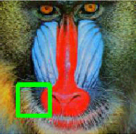






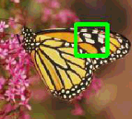













Proposed method : Depth Controllable SR Network (DCSRNet)
Final evaluation result
HR
LR
Bicubic
Depth4
Depth8
Depth20

